Slide 1
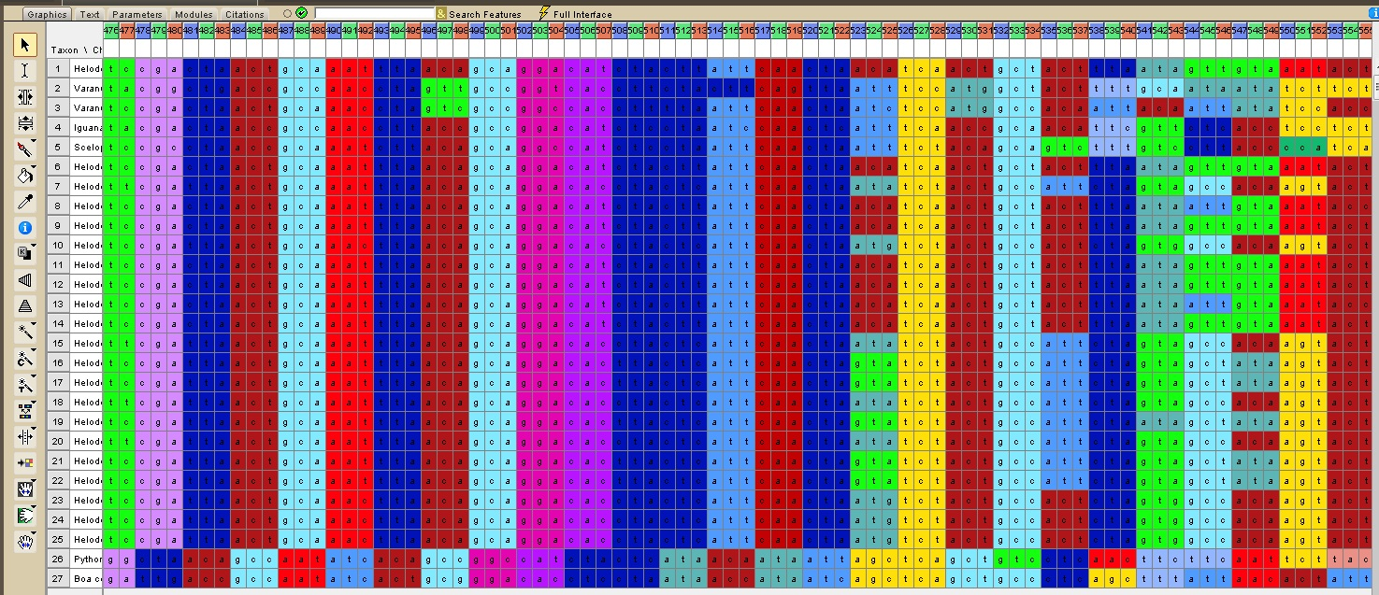
Lab 3: Sequence Alignment and Homology
BIOL 4174/5174: Conservation Genetics Lab
2/7/2018
Slides stolen shamelessly from Steve Mussmann’s 2016 Conservation Genetics course and Jeff Silberman’s 2012 Molecular Phylogenetics course

Slide 2
Homology vs homoplasy
Local and global alignment
Single sequence alignment, BLAST
NCBI Genbank
Multiple Sequence Alignment?
Lab todo:
Script to add .bashrc, install clustalo, clustalw, clustalx, muscle. Make sure Mesquite installed

Slide 3
FIRST update class materials: git pull
/Users
A shortcut to your home directory is ~/
/ConsGen
Other user accounts
/Desktop
/Documents
/Downloads
/local
/username
/ConsGen2018
We want to cd to this directory:
~/Desktop/username/ConsGen2018

Slide 4
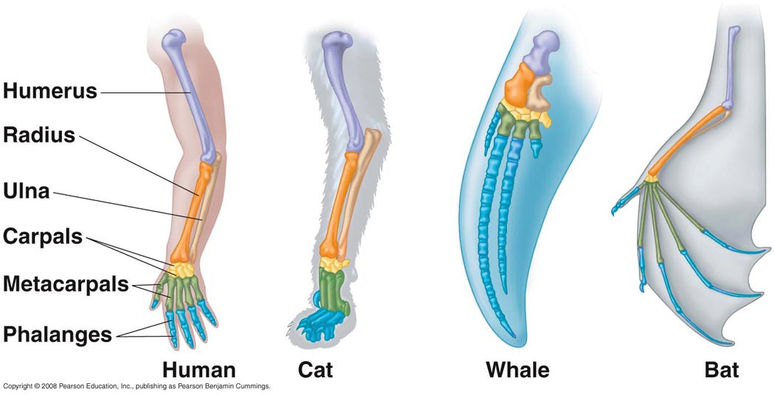
Homology
Homolog: Identity or similarity due to common ancestry
Features in different taxa are homologous if their similarity is a result of common ancestry

Slide 5
Homology
Two apparently dissimilar features can be homologous if they are modified forms (states) of a feature in common ancestor
Arm structures homologous although superficially different
Differences reflect modifications of same ancestral structures
Bird and bat wings: Homologous as forearms, NOT homologous as wings (common ancestor could not fly)

Slide 6
When two species have identical character states, this may reflect:
HOMOLOGY: Both species inherited that character state from a common ancestor, which possessed the same state
HOMOPLASY: The similarity evolved indepentendly in the two species; similarity NOT due to common ancestry
*Only homologous similarity reflects common ancestry*

Slide 7
Two basic sources of homoplasy:

Slide 8
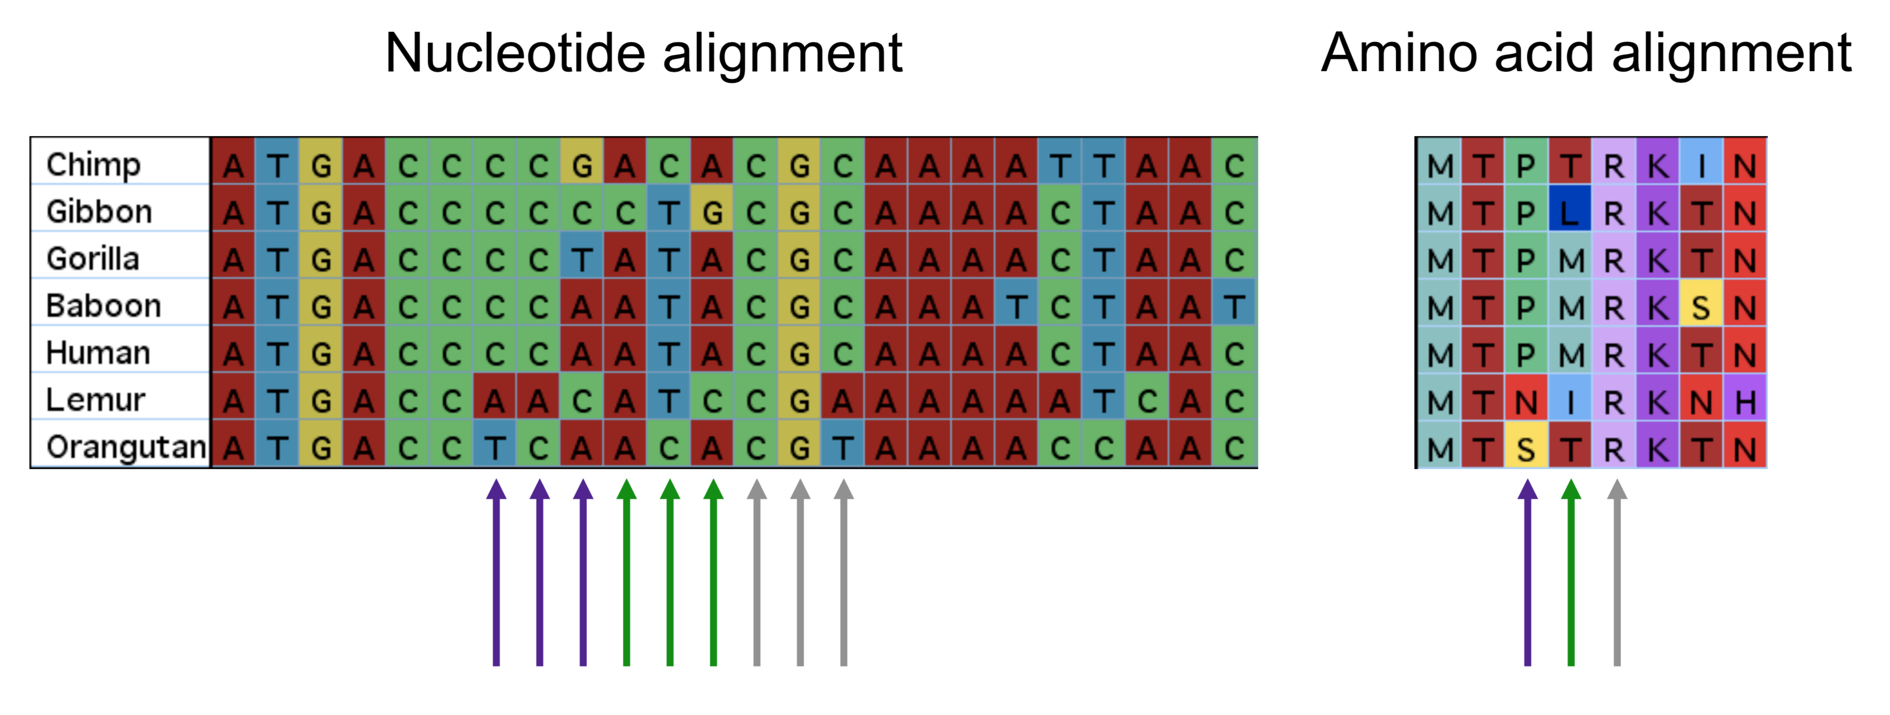
Molecular Homology: Sequence alignment
Statement of homology at level of:
Individual nucleotide in DNA sequence
Amino acids (in coding genes)

Slide 9
**Important: Homology is a hypothesis**

